Slide 1
Week 11: Summarization and a Touch of Question Answering
W266: Natural Language Processing

Slide 2
Peeking ahead...
Week 1- 2: NN Basics & Training
Week 3: Classification & Sentiment
Week 4: Part of Speech + Parsing
Week 5: Convolutional Neural Networks (CNNs)
Week 6 - 7: Language Models
Week 8: Machine Translation
Week 9: Advanced MT: Transformers & Transfer Learning
Week 10: Entities/Information Extraction
Week 11: Summarization and a touch of question answering
Week 12: Document Classification
Week 13: Information Retrieval

Slide 3
Announcements
Final Assignment 7 released 03/06
Due date: Sunday 03/14 at 11:59 pm PST.
Projects
Due Saturday 04/10 11:59 pm PST (hard deadline!)
~ 3 to 4 weeks
Your presentations in class 04/12-04/17.
Questions?
Reminder: Next week - no class (Spring Break)
Concerns?

Slide 4
Announcements (continued)
Paper reading sessions:
Exploiting Cloze Questions for Few Shot Text Classification and Natural Language Inference
Joachim: Thursday, 03/18, Noon PST
Train Large, Then Compress: Rethinking Model Size for Efficient Training and Inference of Transformers
Joachim: Thursday, 04/01, Noon PST
Notebook walkthroughs:
Loss Function Examples Notebook
Anu: Thursday, 03/18, 6:00 pm PST

Slide 5
The plan...
Summarization overview
Evaluation: ROUGE
Summarization: Neural models
A Touch of Question Answering

Slide 6
Summarization
(of async ;)

Slide 7
Summarization Overview
Types of summaries:
Abstractive: “explain in your own words”
Extractive*: build summary from existing text
Humans are mostly abstractive
NLP systems mostly extractive
How would you create a summary?
Start by highlighting relevant passages
Clean up / reword to produce a summary
*Async provides extensive coverage of extractive scoring algorithms

Slide 8
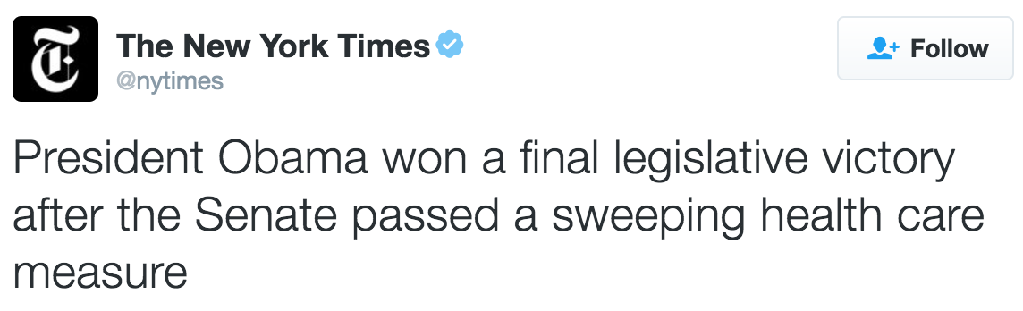
Summarization: Single-Document
News article -> summary
Plenty of data!
(article -> headline)
But, hard to beat baseline
WASHINGTON — The Senate approved complex health care legislation on Wednesday that would increase funding for disease research, address weaknesses in the nation’s mental health systems and vastly alter the regulatory system for drugs and medical devices. The vote sealed a final legislative victory for President Obama, who strongly supported the bill against objections from many liberal Democrats and consumer groups.

Slide 9
Summarization: Single-Document
News article -> summary
Plenty of data!
(article -> headline)
But, hard to beat baseline
WASHINGTON — The Senate approved complex health care legislation on Wednesday that would increase funding for disease research, address weaknesses in the nation’s mental health systems and vastly alter the regulatory system for drugs and medical devices. The vote sealed a final legislative victory for President Obama, who strongly supported the bill against objections from many liberal Democrats and consumer groups.
Problem: “inverted pyramid” writing style - just pick first paragraph

Slide 10
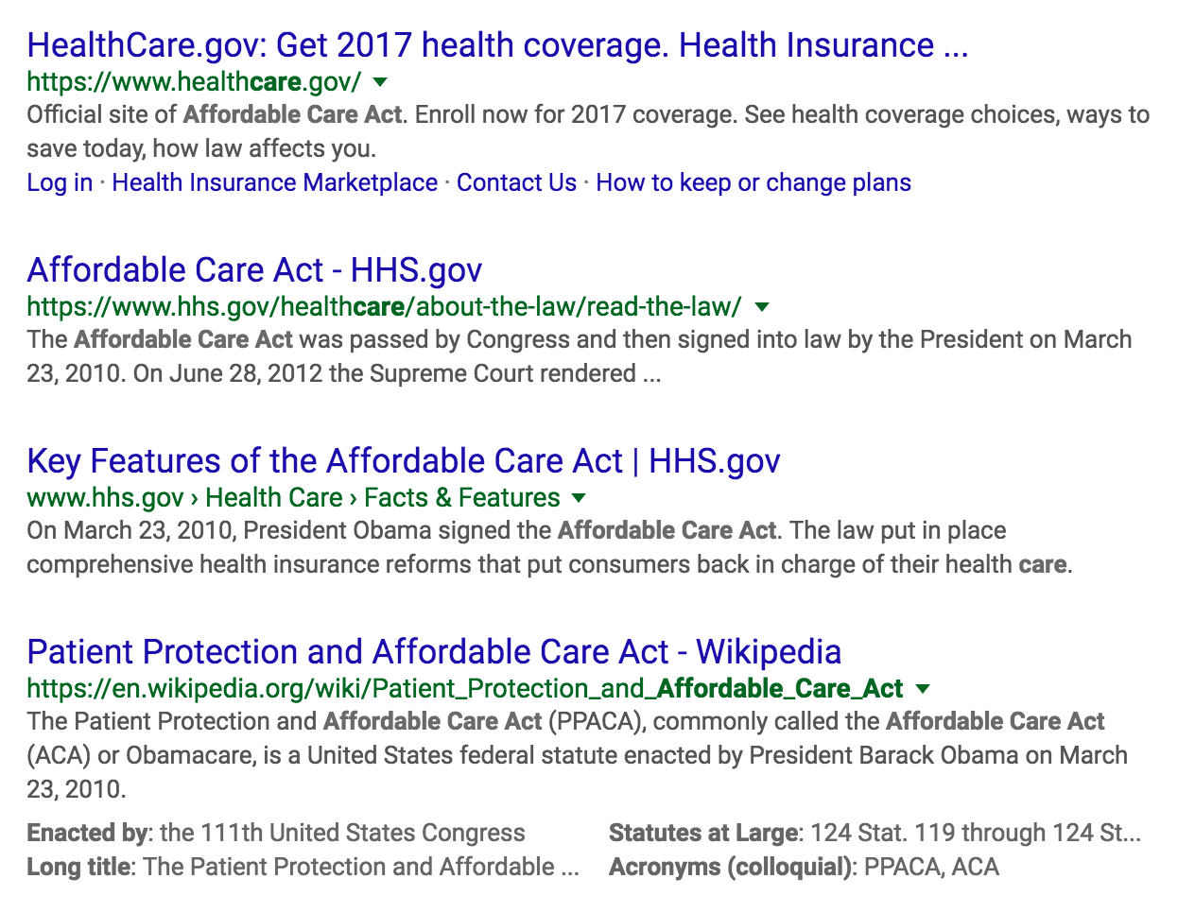
Summarization: Multi-Document
Summarize multiple documents [optional: in response to query]

Slide 11
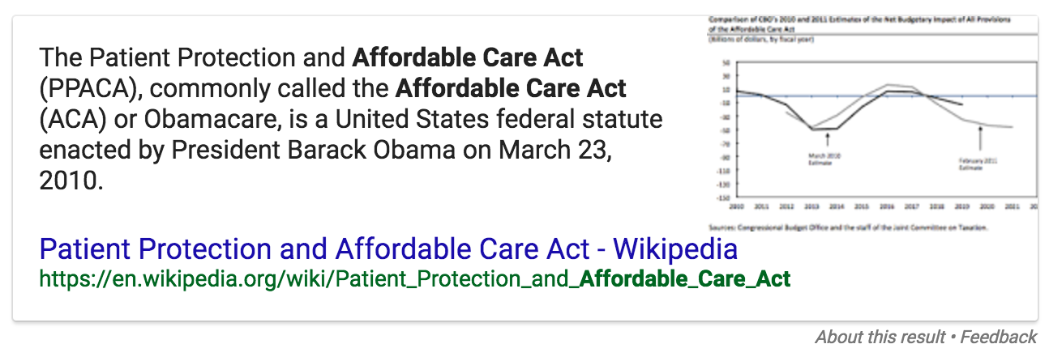
Summarization: Multi-Document
Summarize multiple documents [optional: in response to query]

Slide 12
Evaluation: ROUGE

Slide 13
Summarization: Evaluation
Many criteria:
Information satisfaction (answer query)
Coverage (summarize corpus)
Fluency (sounds natural)
Concision (not redundant, no fluff)
Hard to measure and hard to tune for!
Data: reference summaries (similar to MT)
No “right answer” - hard to optimize (are we overfitting reference?)

Slide 14
Summarization: Evaluation
Problems are all very similar to Machine Translation.
What did we do there?
Can we do the same thing here?

Slide 15
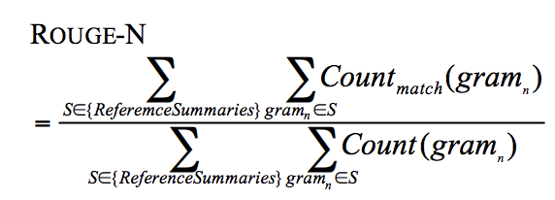
Summarization: Evaluation
In BLEU, we cared about precision:
How many n-grams in the candidate are in a reference translation?
In ROUGE, we care about recall:
How many n-grams in the reference summaries are in the candidate?
“Did we include all the salient points in our limited length summary?”

Slide 16
Summarization: Evaluation
Several forms of ROUGE.
ROUGE-N: N-gram overlap as described on previous slide
ROUGE-L: Longest common subsequence
ROUGE-S: Skipgram (any pair of words in a sentence)

Slide 17
Neural Models

Slide 18
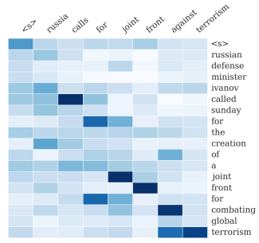
Neural Compression Models
Sequence-to-Sequence
Input: original sentence
Output: compressed sentence
Use attention to improve performance
Model architecture like neural MT!
Source: A Neural Attention Model for Abstractive Sentence Summarization , Rush et al. 2015

Slide 19
Neural seq2seq Models for Summarization
End-to-End Sequence-to-Sequence models:
Input: the document that needs to be summarized
Output: summary
Argentina
defeated
brazil
</s>
</s>
<s>

Slide 20
Beam Search To The Rescue
Beam Search: Don’t fully commit.. leave fixed number of options in play !
Keep Top N candidates at each step i…
… calculate for each candidate the next word’s probability distribution, keep top N of those
… that gives N² new combined candidates at step i+1
… and keep Top N of those
… keep doing this Simple!

Slide 21
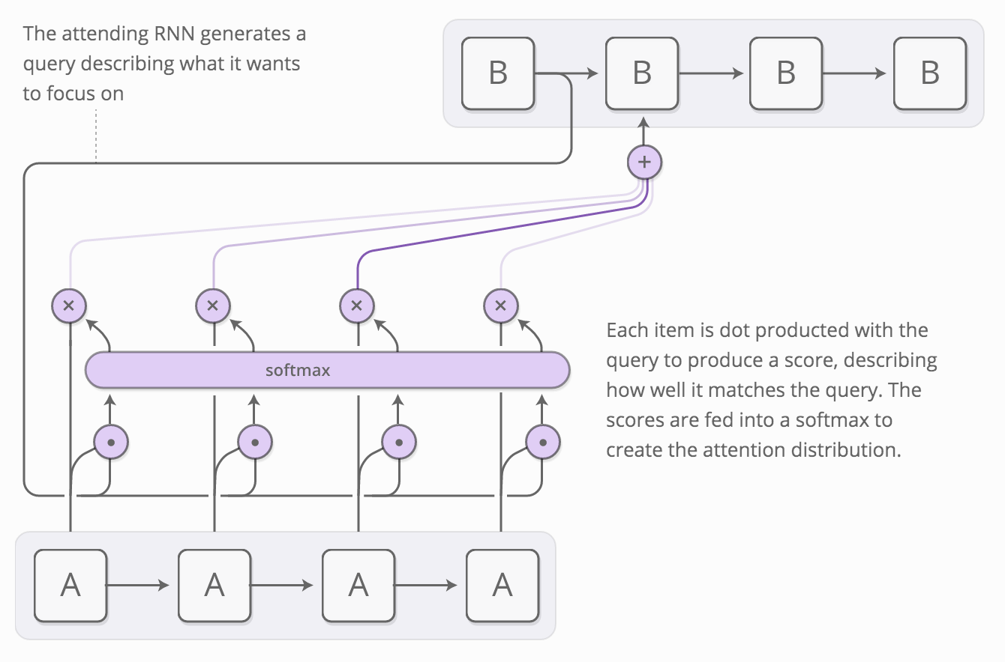
Attention Models
Problem: fixed-length vector representation
Bad for long sentences!
Idea: allow model to look back at input sequence during decoding
Acts as a sort of “memory”
Cognitively plausible?
Bonus: get alignments! (or something like them)
Image by Chris Olah and Shan Carter

Slide 22
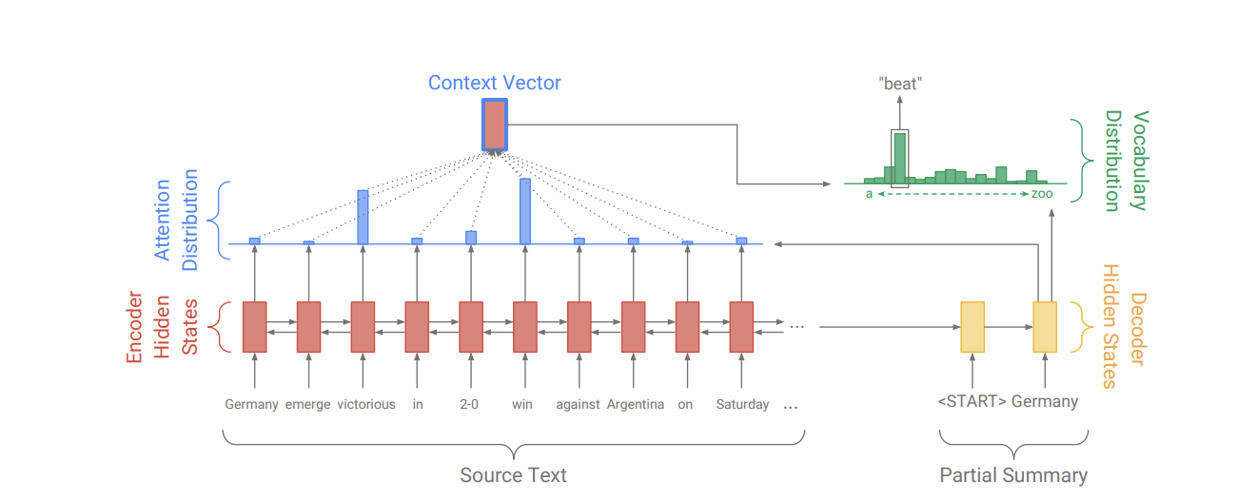
Neural Compression Models
Encoder/Decoder RNN attention model, similar to machine translation
At each step, softmax over the vocabulary
Beam search over possible decodings to produce summary
(*)
(*) Get To The Point: Summarization with Pointer-Generator Networks

Slide 23
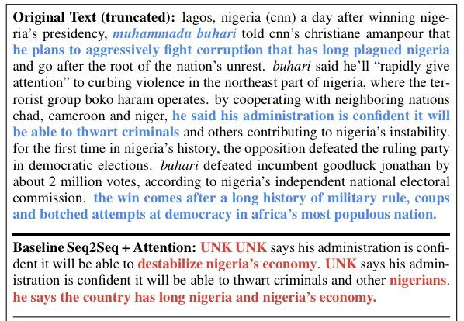
Neural Compression Models
Even with attention what problems still occur?
Unknown Tokens
Factual Errors (Faithfulness)
Nonsense sentences (Fluency)
Source: Get To The Point: Summarization with Pointer-Generator Networks

Slide 24
Neural Compression: Get to the Point
Abstractive? Extractive? Why pick?
Idea: sometimes copy text from source material & sometimes find a new word
Concretely:
Build an attention model with a softmax over a RNN as usual
Add to this structure p(generate), the probability we generate from the softmax (vs. just copying a word)
Final word distribution is:
p(generate) x softmax output + (1 - p(generate)) x attention_{(context vectors)}

Slide 25
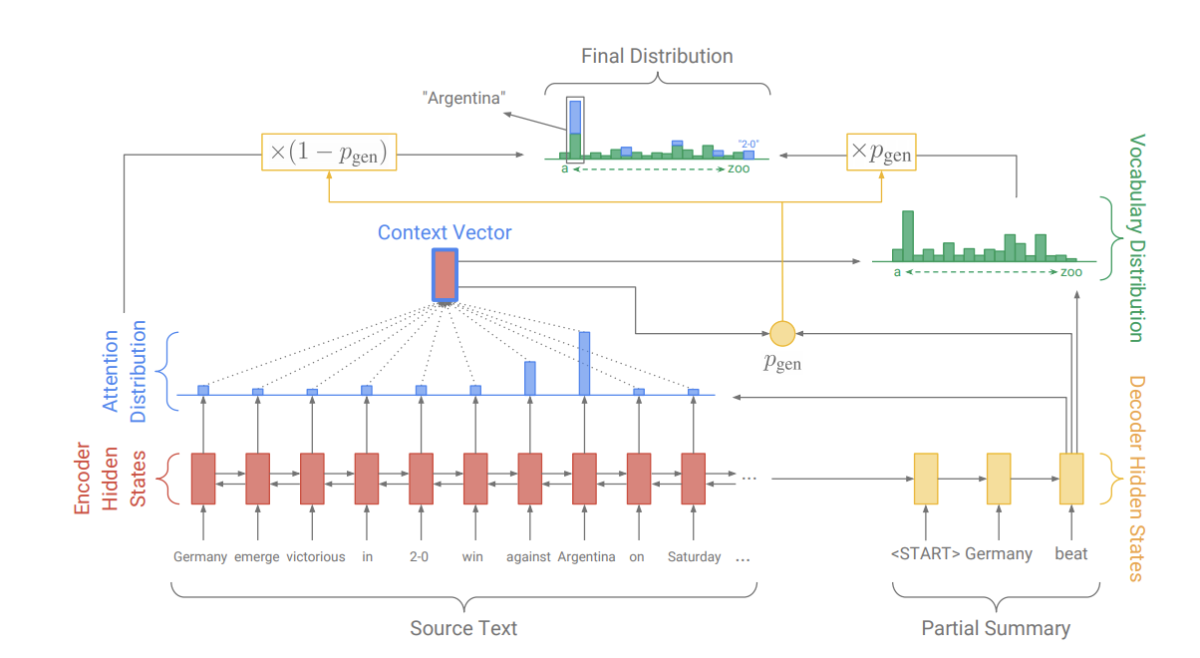
Neural Compression: Get to the Point
(*)
(*) Get To The Point: Summarization with Pointer-Generator Networks

Slide 26
Neural Compression: Get to the Point
(*)
Q: are we done?
Abstractive + Extractive => yay!
Only scales to short passages :(
(*) Get To The Point: Summarization with Pointer-Generator Networks

Slide 27
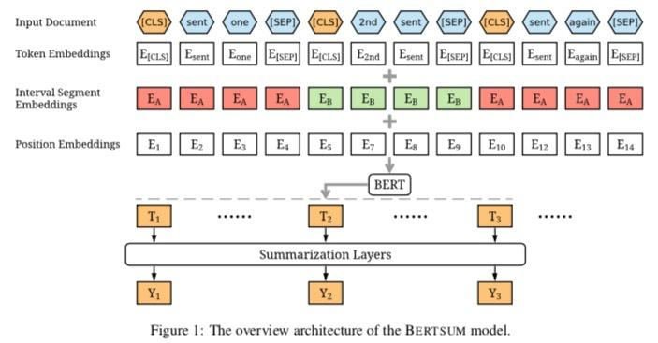
BERT and Extractive Summarization
E_{C}
CLS vector for each sentence
Learn score for each sentence in fine-tuning
Pick top 3 sentences with trigram blocking
Source: Fine-tune BERT for Extractive Summarization
Notes:
Source: Fine-tune BERT for Extractive Summarization

Slide 28
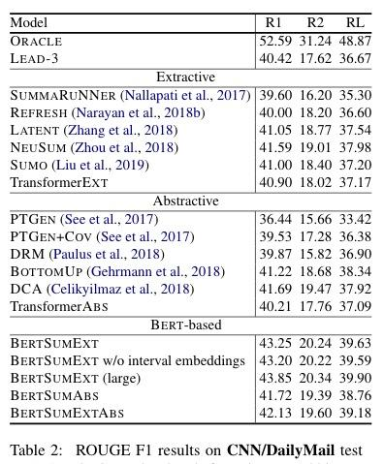
BERT and Abstractive Summarization
Uses pre-trained BERTSUM to identify sentences
Uses 6 layer transformer as decoder to emit summary
Two stage fine-tuning of encoder: first extractive, then abstractive
Decode until EOS token with beam search (k=5)
Tri-gram blocking
Source: Text Summarization with Pretrained Encoders

Slide 29
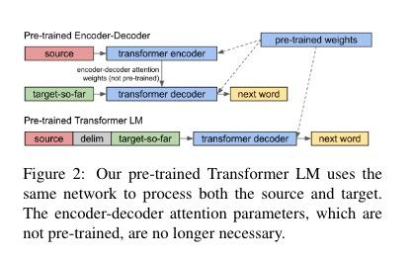
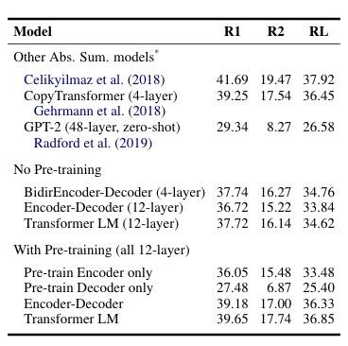
Transformer LM and Abstractive Summarization
Compare Encoder/Decoder approaches with and without pre-training:
Encoder/Decoder structure
Decoder (like GPT-2) emits summary based on source input
Adapted from: Sample Efficient Text Summarization Using a Single Pre-Trained Transformer
Notes:
X: My name is paul Y: Je m’appel Paul Some X, Y pairs that show up in the training set might be….. X: My name is Paul <delim> Je m’ Y: appel
X: My name is Paul <delim> Je Y: m’ X: My name is Paul <delim> Je m’appel Y: Paul

Slide 30
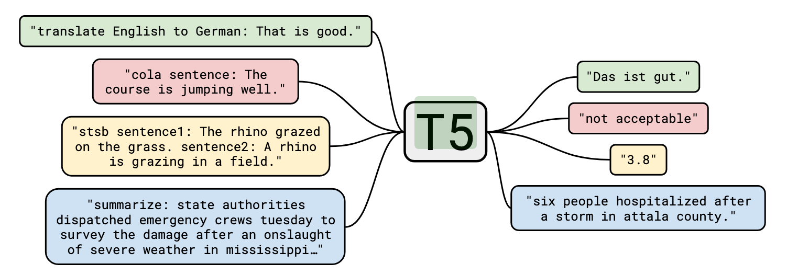
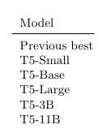
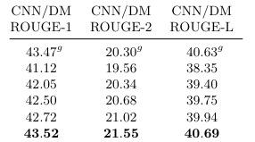
T5 Summarization
Testing pre-trained Encoder + Decoder transformer architecture
Final results with best hyperparameters including span corruption, multi-task learning, and beam size = 4
Source: ”Exploring the Limits of Transfer Learning with a Unified Text-to-Text Transformer”, Raffel et al, https://arxiv.org/pdf/1910.10683.pdf

Slide 31
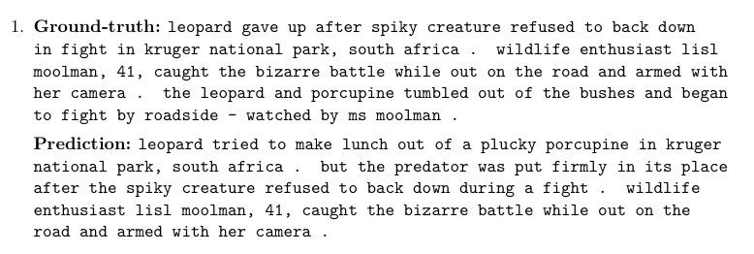
T5: Wall of Fame (T5-11B, not cherry picked)
Source: ”Exploring the Limits of Transfer Learning with a Unified Text-to-Text Transformer”, Raffel et al, https://arxiv.org/pdf/1910.10683.pdf
Notes:
Faithfulness? Fluency? Repetition?

Slide 32
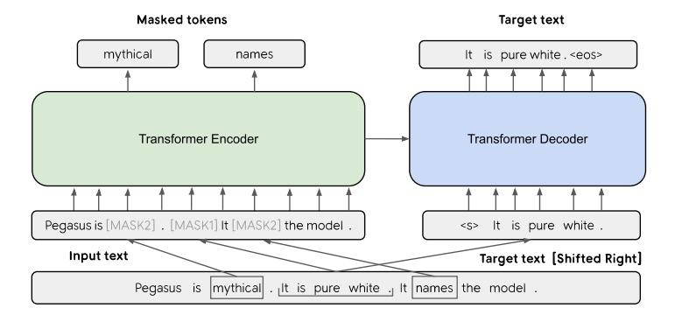
PEGASUS: Transformers for Abstractive Summarization
Adapted from: PEGASUS: Pre-training with Extracted Gap-sentences for Abstractive Summarization and PEGASUS: A State-of-the-Art Model for Abstractive Text Summarization

Slide 33
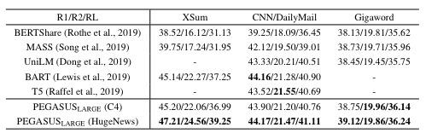
PEGASUS: Transformers for Abstractive Summarization
Encoder/Decoder architecture with novel gap-sentence pre-training:
Encoder learns MLM task
Decoder learns to predict missing sentences, selected for high ROUGE score
SOTA on multiple summarization corpora
Experiments with fine-tuning levels
Adapted from: PEGASUS: Pre-training with Extracted Gap-sentences for Abstractive Summarization and PEGASUS: A State-of-the-Art Model for Abstractive Text Summarization

Slide 34
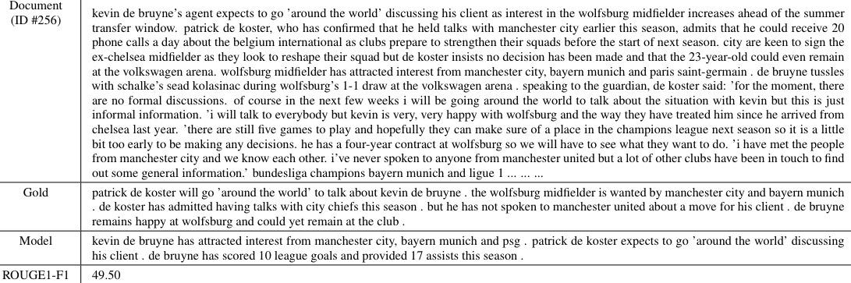
PEGASUS: Wall of Fame (CNN/DM example)
Adapted from: PEGASUS: Pre-training with Extracted Gap-sentences for Abstractive Summarization and PEGASUS: A State-of-the-Art Model for Abstractive Text Summarization
Notes:
Faithfulness? Fluency? Repetition?

Slide 35
A Touch of Question Answering

Slide 36
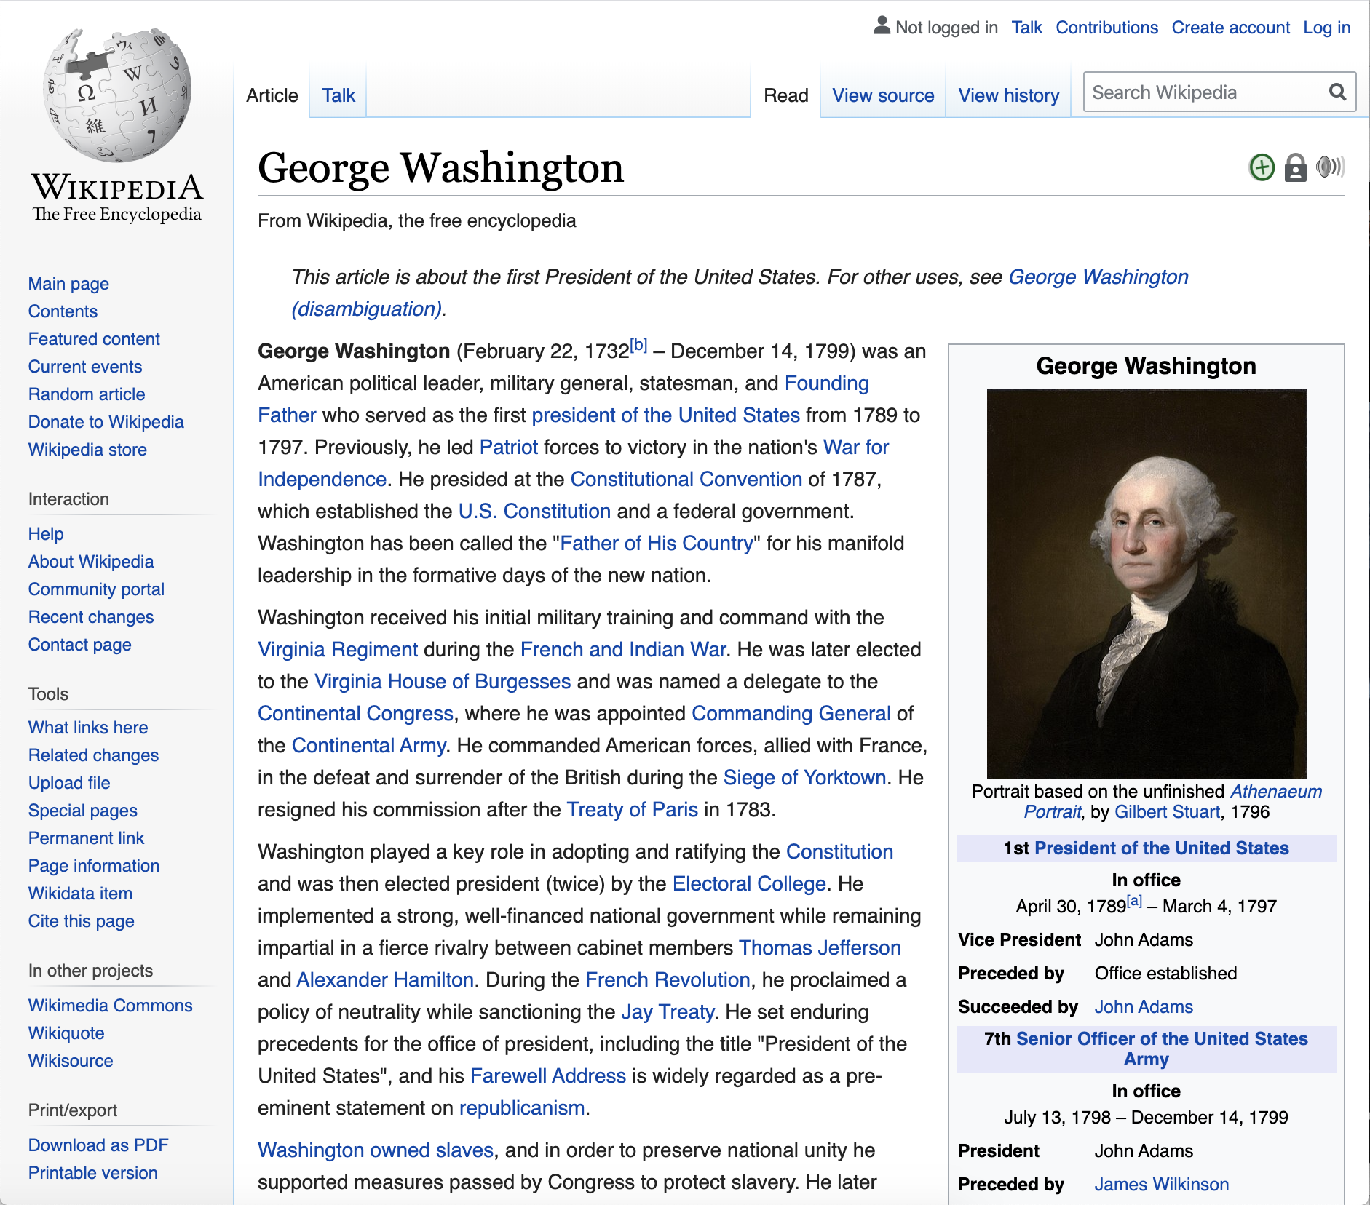
Question Answering (QA)
What if rather than a general summary, you want to answer a specific question? Enter Question-Answering Summarization Give me the overall highlights from a document. George Washington was an American political leader, military general, statesman, and Founding Father who served as the first president of the United States from 1789 to 1797. Question-Answering Provide the highlights with respect to a specific question. Where did George Washington get his military training? Washington received his initial military training and command with the Virginia Regiment during the French and Indian War.

Slide 37
Summarization and QA
(unstructured) Question-Answering ≈ Summarization w.r.t. a query
[Conversely: summarization ≈ QA without the Q]
“Factoid”-seeking queries → very short “summaries”
Similar algorithms and evaluation!
query
docs
S = f(docs)
docs
A = f(docs, Q)
Note: there are other ways to do QA! (e.g. fully-structured)
Notes:
Async (and today), we’ll switch between the two. But the main lessons are the same with or without a query!
Note that there are other ways to do QA, for example, fully-structured QA using semantic parsing and knowledge bases.

Slide 38
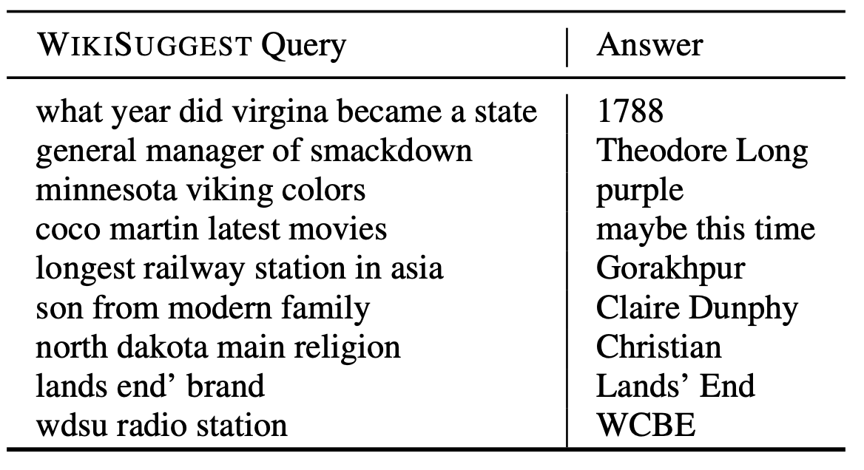
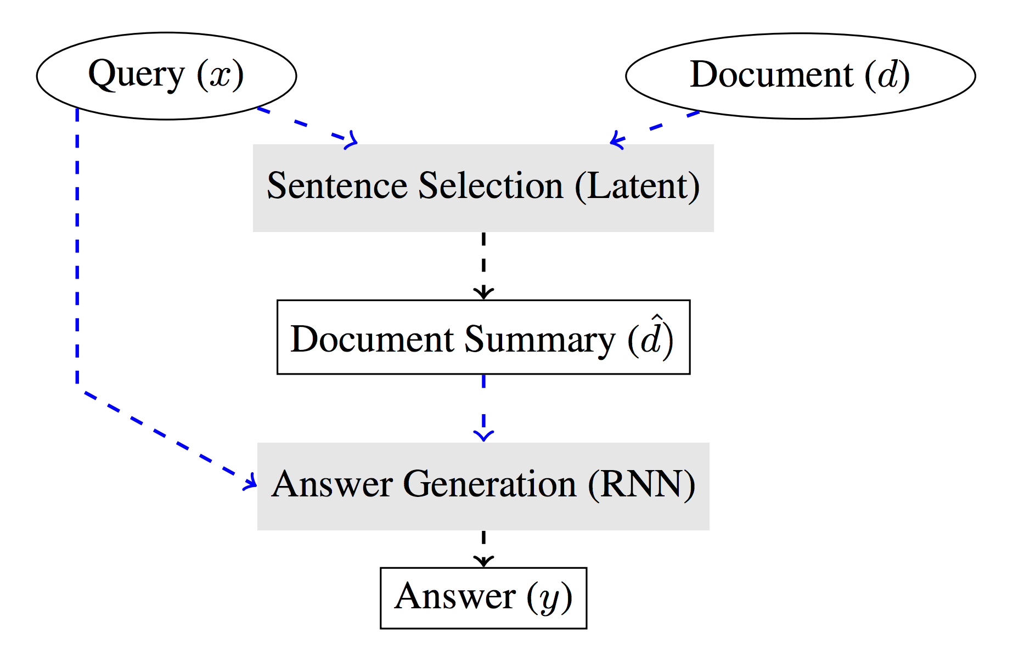
Neural Summarization + Query Based Question Answering
Coarse-to-Fine Question Answering for Long Documents (Choi et al., ACL 2017)
Pipeline approach: select sentences, generate answer
NN selection model: p(s | q)
“Soft” selection: average sentences, use attention (slow!)
“Hard” selection: use REINFORCE - fast!
From selection, generate A = f({s, ...} | q) using RNN

Slide 39
QA Task Variants
Question-Answering provides answers to plain text questions based on a passage, document, or corpus*
Span annotation: Given a question and passage, highlight the text in the passage that answers the question (SQuAD, Natural Questions). Most popular
Multiple Choice: Given a question and a passage, select the correct answer to multiple choice question (RACE, Children’s book test, MC Test) Similar to edu standardized tests
Free-form (/summarized) answers: Given a question and supporting text, generate a free-form answer (MS MARCO, Conversational QA - CoQA). Evaluation Issues?
Retrieval: Given a question and a supporting document or corpus, retrieve the sentence that answers the question (WikiQA, Yahoo Answers!, ReQA SQuAD, ReQA Natural Questions) Most useful for applied tasks?
* Multimodal Questions about an image (CLEVR)
Notes:
Multimodal is red and starred since it's fairly different than the other text based QA tasks.

Slide 40
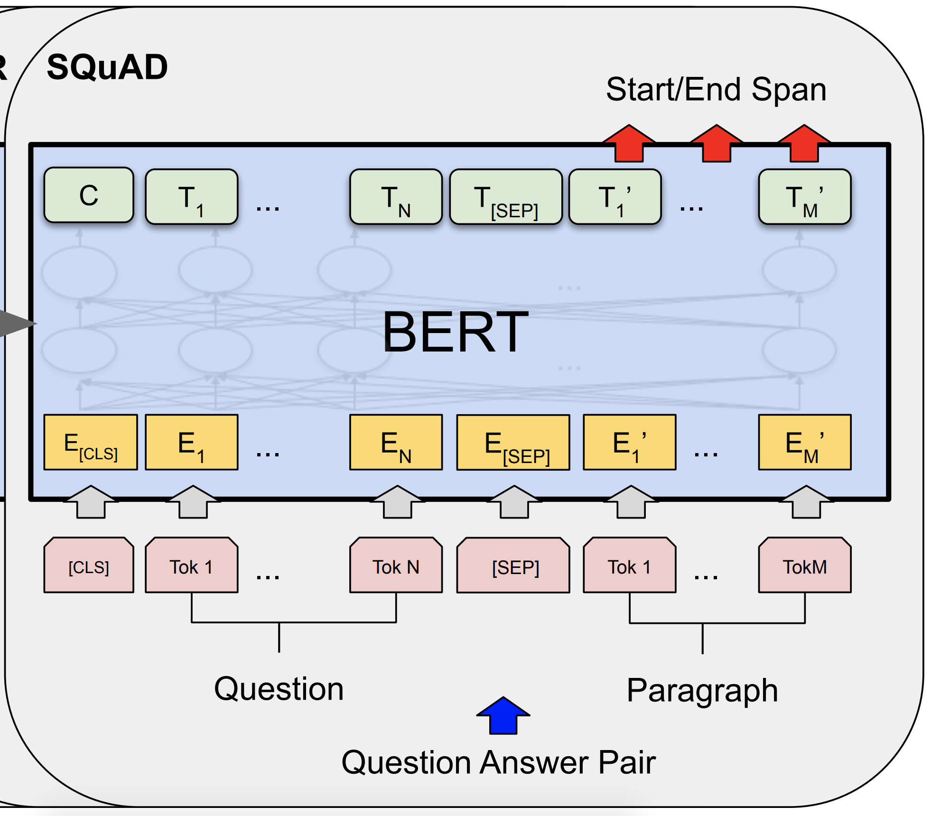
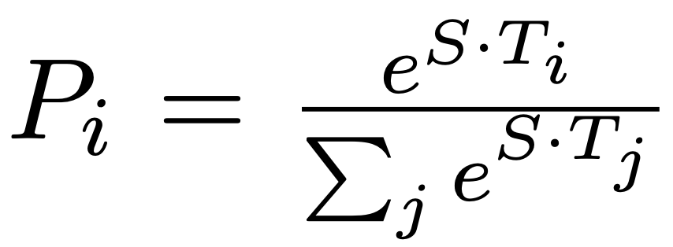
Span Annotation
Span annotation: Given a question and passage, highlight the text in the passage that answers the question (e.g., SQuAD, Natural Questions).
Recipe: Provide question and paragraph to BERT model divided by a special [SEP] token. Fine-tune output layer to predict start and end span annotations.
Unanswerable Questions (SQuAD 2.0)? Start and end of span is the [CLS] token Evaluation: Exact match and F1 over tokens.
Start/end spans identified by softmax over all output positions
Devlin et al., 2018

Slide 41
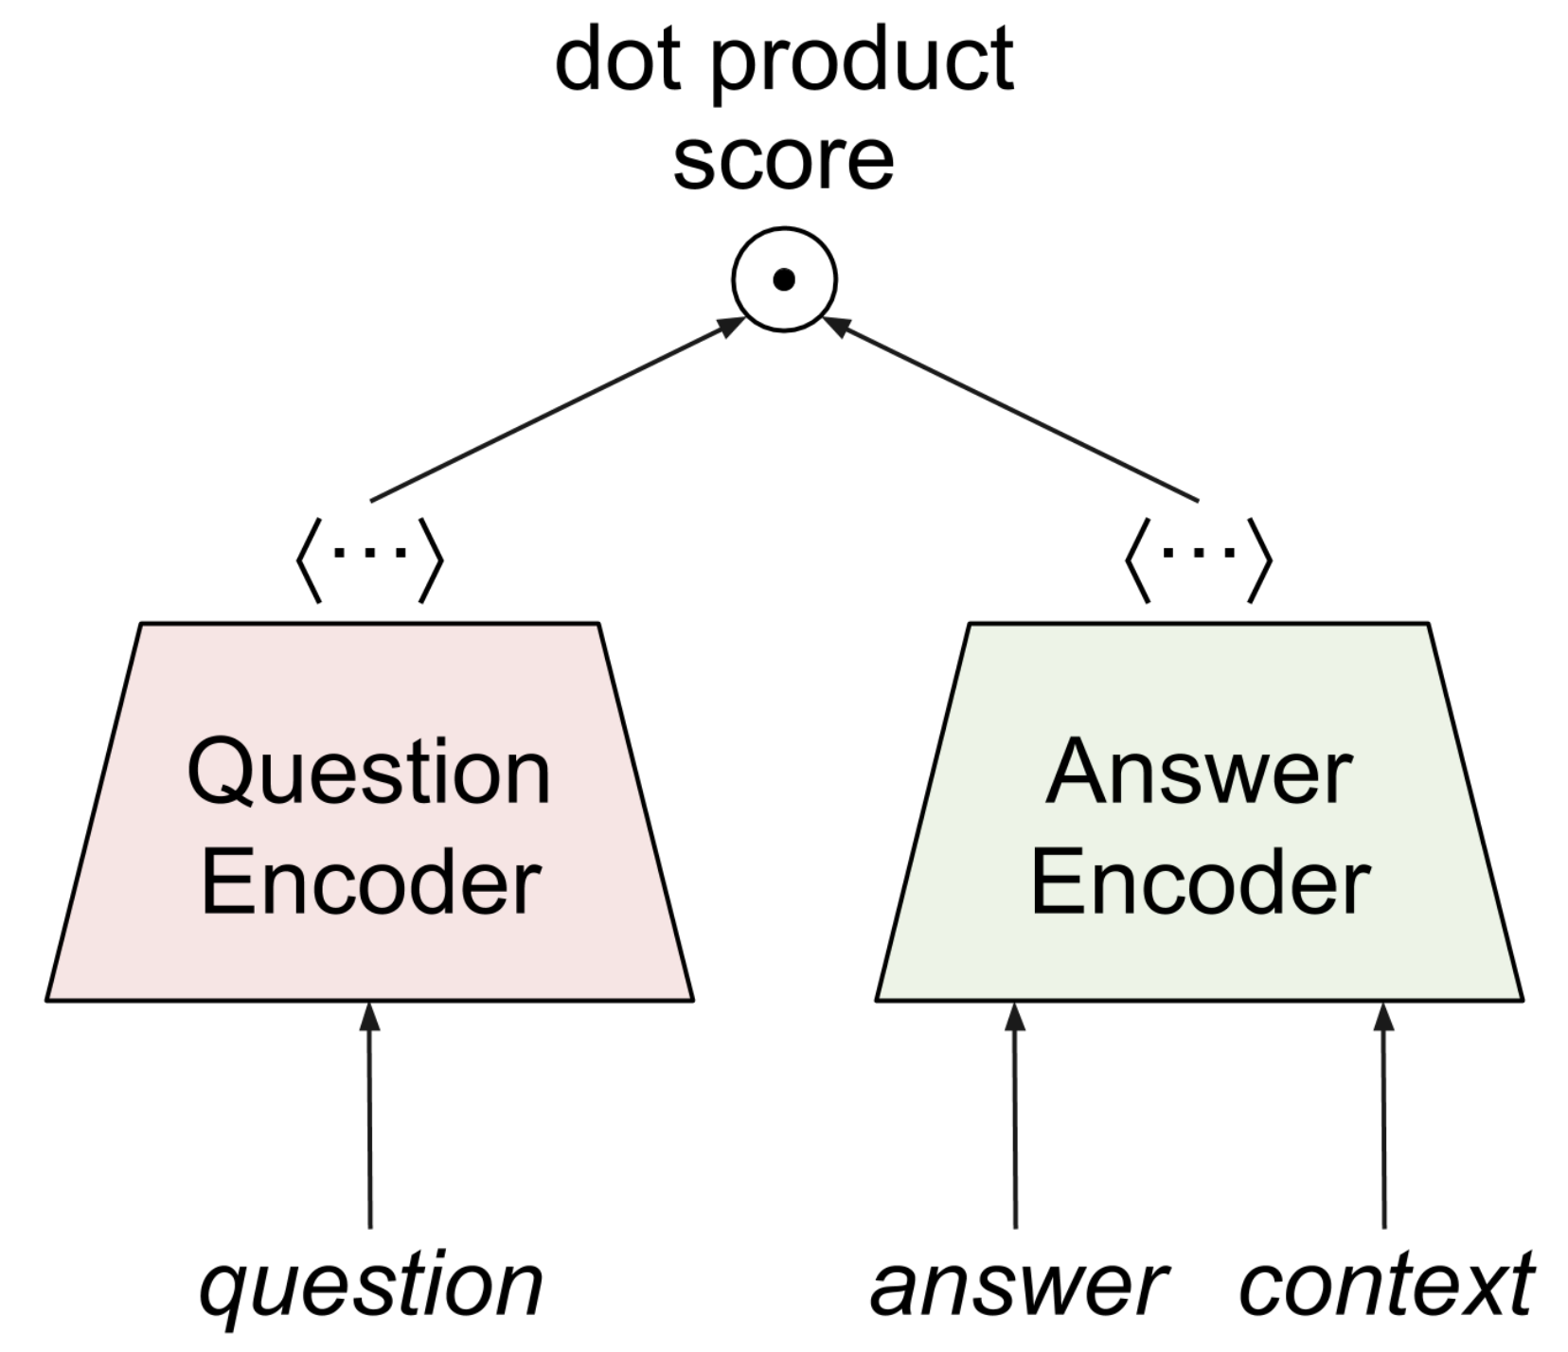
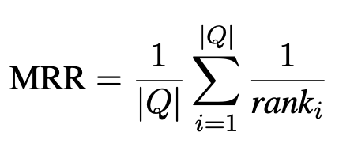
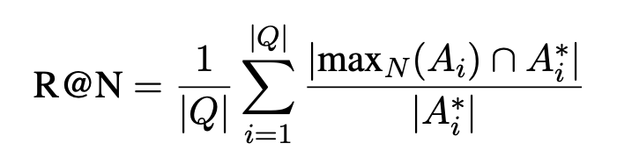
Retrieval Question Answering (ReQA)
Retrieval: Given a question and a supporting document or corpus, retrieve the sentence that answers the question (WikiQA, Yahoo Answers!, ReQA SQuAD, ReQA Natural Questions)
Recipe: Provide question and all possible answers to dual encoder model. Retrieval best match using fast k-nearest neighbor (k-nn) search (e.g., Faiss)
Encode all possible answers!?! Answers encodings are precomputed and indexed for efficient k-nn. Evaluation Information Retrieval based metrics - Recall @ N (R@N) and mean reciprocal rank (MRR)
Ahmad et al., 2019

Slide 42
Question Answering
Many Data sets
SQuAD (Rajpurkar et al., 2016)
NewsQA (Trischler et al., 2016)
TriviaQA (Joshi et al., 2017)
SearchQA (Dunn et al., 2017)
HotpotQA (Yang, Qi, Zhang, et al., 2018)
NaturalQuestions (Kwiatkowski et al., 2019)
BioASQ
DROP (Dua et al., 2019)
DuoRC (Saha et al., 2018)
RACE (Lai et al., 2017)
RelationExtraction (Levy et al., 2017)
TextbookQA (Kembhavi et al., 2017)
BioProcess (Berant et al, 2014)
ComplexWebQuestions (Talmor and Berant, 2018)
MCTest (Richardson et al, 2013)
QAMR (Michael et al, 2018)
QAST (Lamel et al, 2008)
TREC (Baudis and Sedivy, 2015)
MRQA: Machine Reading for Question Answering 2019 Workshop at EMNLP
Very active area of research Multiple task formulations; many datasets and models. Possibly a unifying framework for all NLP tasks? decaNLP The Natural Language Decathlon: Multitask Learning as Question Answering McCann et al., 2018 Related to summarization, particularly in response to query. Differences?
Query Affordable Care Act

Slide 43
End

Slide 44
Brainstorming: Classification…
Classify these three tweets as 0 or 1:
“This flick was really bad. Poor acting." -> The movie should quite terrible. Bad actors’
"This joint was terrific. Great! Really nice flavors."
"My meal at the place was terribly prepared. Way too spicy.”
Any issues with this task as given?
If that is resolved, what is the canonical classification approach?

Slide 45
Brainstorming: Classification… With Masked LMs*
What about this instead:
“This flick was really bad. Poor acting. I had a [MASK] experience."
"This joint was terrific. Great! Really nice flavors. I had a [MASK] experience."
"My meal at the place was terribly prepared. Way too spicy. I had a [MASK] experience.”
Is this better? Why?
And how could we now classify as ‘good’ or ‘bad’?
*Based on : “Exploiting Cloze Questions for Few Shot Text Classification and Natural Language Inference”, Timo Schick, Hinrich Schuetze (Thursday’s paper reading session)

Slide 46
Brainstorming: Classification… With Masked LMs*
… or this:
“This flick was really bad. Poor acting. The previous phrase talked about [MASK]."
"This joint was terrific. Great! Really nice flavors. The previous phrase talked about [MASK]."
"My meal at the place was terribly prepared. Way too spicy. The previous phrase talked about [MASK].”
Is this better? Why?
And how could we now classify as ‘restaurants’ or ‘movies’?
*Based on : “Exploiting Cloze Questions for Few Shot Text Classification and Natural Language Inference”, Timo Schick, Hinrich Schuetze (Thursday’s paper reading session)

Slide 47
Brainstorming: Classification… With Masked LMs*
… or this:
“The councilmen did not give a permit to the protestors because they feared violence. Therefore they refers to councilmen and not to protestors is a [MASK] statement."
Labels: they, councilmen, protestors, TRUE/FALSE
*Based on : “Exploiting Cloze Questions for Few Shot Text Classification and Natural Language Inference”, Timo Schick, Hinrich Schuetze (Thursday’s paper reading session)

Slide 48
Labeled subset T
Big full unlabeled set D
Pick PVPs
‘Label’ all examples in D
Train a standard classifier on D as if it was fully labeled

Slide 49
Brainstorming: Summarization
Consider this paragraph:
"PG&E stated it scheduled the blackouts in response to forecasts for high winds amid dry conditions. The aim is to reduce the risk of wildfires. Nearly 800 thousand customers were scheduled to be affected by the shutoffs which were expected to last through at least midday tomorrow."
How would you go about summarize it?
How would you evaluate a summary?
How would you consider building a model that does the summarization?

Slide 50
Other (older) Models
Notes:
a lot of intuitive as a direct extrapolation from Translation.
1) Problem... why similar to translation?
2) Metric discussion
3) which architectures could we build?
4) what are issues with pre-training?...

Slide 51
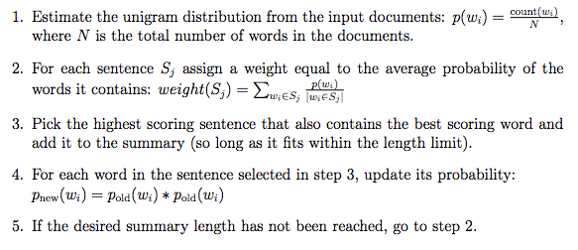
A Simple Sentence Selection Approach: SumBasic
Very simple - not query based.

Slide 52
A Simple Sentence Selection Approach: SumBasic
Very simple - not query based.
Q: what is implied “objective”?

Slide 53

Maximum Marginal Relevance
Greedy search for most relevant sentences
Have: relevance metric, similarity metric
Find most relevant sentence
Repeat: find most relevant sentence that’s not redundant
http://www.cs.cmu.edu/~jgc/publication/The_Use_MMR_Diversity_Based_LTMIR_1998.pdf

Slide 54
Summarization as Optimization

Slide 55
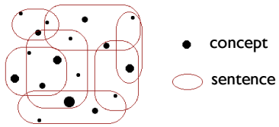

Weighted Maximum Coverage
Goal: cover all relevant concepts, within length limit
Need length limit to get summary (otherwise, trivial)
But, length limit makes it NP-Complete
Notes:
https://en.wikipedia.org/wiki/Maximum_coverage_problem
http://digitalassets.lib.berkeley.edu/techreports/ucb/text/EECS-2011-47.pdf

Slide 56
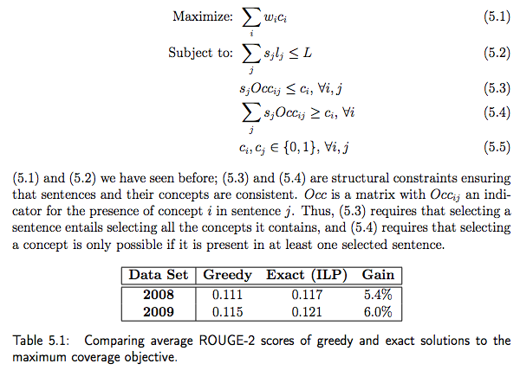
Formulate as Optimization (ILP)
Linear program: linear objective, linear constraints
Easy with continuous variables [0,1]
NP-Hard with discrete {0,1}
Good solvers exist!

Slide 57
Formulate as Optimization (ILP)
Standard form of optimization specification
wi: Credit for including concept i
ci: 1 or 0, whether we included concept i
sj: 1 or 0, whether we included sentence j
Occij: 1 or 0, whether concept i Occurs in sentence j
5.3: If we include sentence j, we must include all of its concepts.
5.4: If we decide to include concept i, we must have at least one sentence that includes it

Slide 58
Formulate as Optimization (ILP)
Linear program: linear objective, linear constraints
Easy with continuous variables [0,1]
NP-Complete with discrete {0,1}
Good solvers exist!
Q: are we done?

Slide 59
Formulate as Optimization (ILP)
Linear program: linear objective, linear constraints
Easy with continuous variables [0,1]
NP-Complete with discrete {0,1}
Good solvers exist!
Q: are we done?
Still extractive
Need to identify “concepts”
Need to create fluent output

